Slide 1
NALAYATHIRAN PROJECT AI BASED DISCOURSE FOR BANKING INDUSTRY
TEAM ID - PNT2022TMID29862
TEAM MEMBER
VINISHA R– 610519104114
SHAHEERABANU C – 610519104091
YOGAMALYA P – 610519104118
SANDHIYA P – 610519104085

Slide 2
Problem Statement
A chatbot is a computer program that simulates and processes human conversation (either written or spoken), allowing humans to interact with digital devices as if they were communicating with a real person.
Chatbots can be as simple as rudimentary programs that answer a simple query with a single-line response, or as sophisticated as digital assistants that learn and evolve to deliver increasing levels of personalization as they gather and process information.
Driven by AI, automated rules, natural-language processing (NLP), and machine learning (ML), chatbots process data to deliver responses to requests of all kinds. Task-oriented (declarative) chatbots are single- purpose programs that focus on performing one function.
Using rules, NLP and ML, they generate automated but conversational responses to user inquiries. Interactions with these chatbots are highly specific and structured and are most applicable to support and service functions—think robust, interactive FAQs. Task-oriented chatbots can handle common questions, such as queries about hours of business or simple transactions that don’t involve a variety of variables
When a user raises a query, it will respond based on what it knows at that point of time. If the conversation comes to place where it doesn’t know what to do, the chat bot will pass the conversation to the human operator.
Over the time and over multiple interactions, the chatbots will gradually gain its scope and relevance. So our chatbots, aided with IBM Watson, will be effectively able to answer user queried thereby enabling them to create a bank account, answer loan queries and general banking queries and queries regarding net banking.

Slide 3
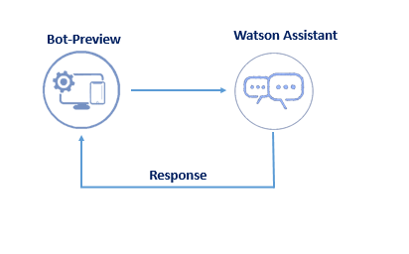
TECHNICAL ARCHITECTURE

Slide 4
REQUIREMENTS SPECIFICATION
FUNCTIONAL REQUIREMENTS
FR No. | Functional Requirement (Epic) | Sub Requirement (Story / Sub-Task)
FR-1 | Saving Account Related Action | As a user , I can see a watson assistant , chatbot having banking related skills
FR-2 | Current Account Related Action | As a user I can converse with the chatbot regarding saving account related qurries and chatbot regarding current account relatrd queries
FR-3 | General Queries Related Actions | As a user I can converse with the chatbot regarding loan account related qurries and regarding net banking queries
FR-4 | Loan Account Related Actions | As a user I can see a flask page for bankand web page integrated with the chatbot
FR-5 | Net Banking Related Actions | As a user I can communicate with the chatbot 24*7

Slide 5
NON-FUNCTIONAL REQUIREMENTS
FR No. | Non-Functional Requirement | Description
NFR-1 | Usability | Chatbots Developed using AI Should be able to answer any general banking queries an Account Creation, Loan, Net Banking, Other Services etc. It’s Effectively in a cost efficient manner.
NFR-2 | Security | The AI Chatbot maintains a confidential Conversation with customers. Chatbot will provided personal and efficient communication between user and bank.
NFR-3 | Reliability | Chatbot are trained very well using AI to provide solution for the popular and frequently asked question, there by providing the best suited services quickly.
NFR-4 | Performance | AI Chatbots are great way to overcome the limitation of workload of humans. There can be multiple instances of a single Chatbot inquiring different people at the same time. This ensures faster, easier and more efficient face-time with customers.
NFR-5 | Availability | AI chatbots provide 24/7 services to clear all customer queries and guide them through all the banking processes. It’s Available to any one with access to the internet with basic Hardware.
NFR-6 | Scalability | AI chatbots are helping banking industry to scale their customer service and to improve customer service satisfaction at the same time.

Slide 6
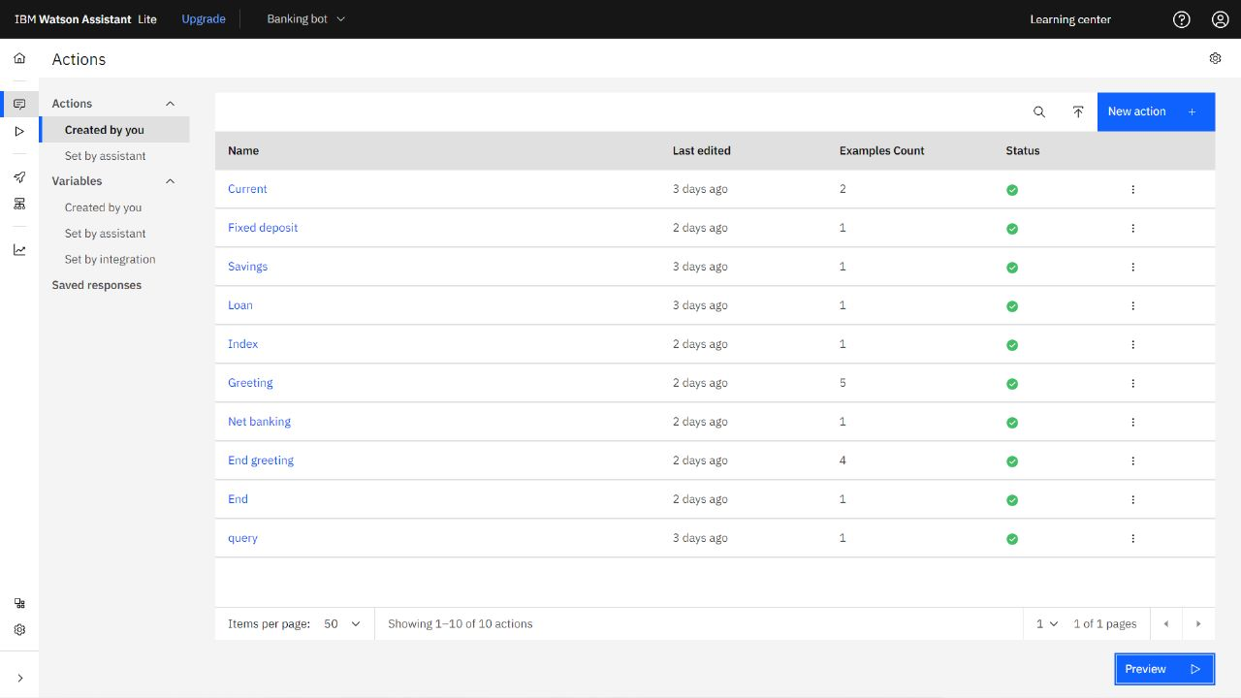
IBM WATSON

Slide 7
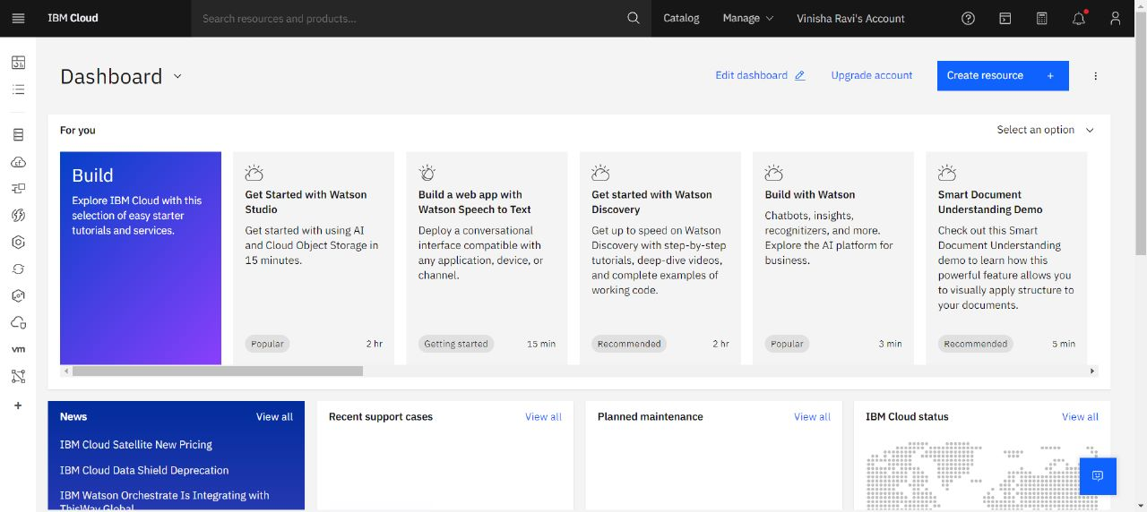
IBM CLOUD

Slide 8
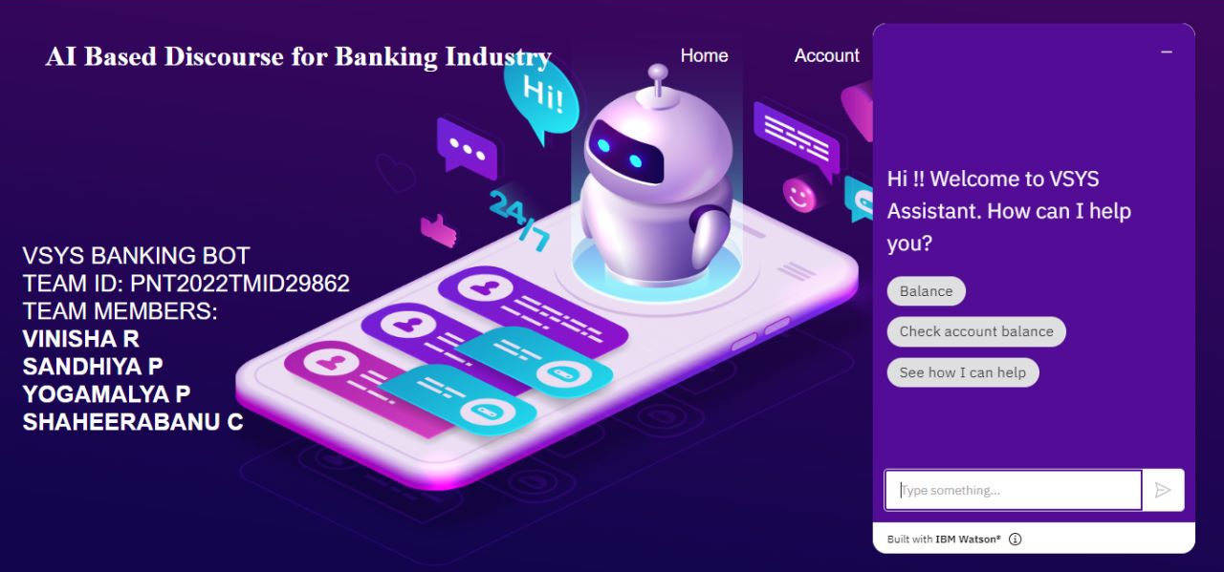
BANKING WEBSITE

Slide 9
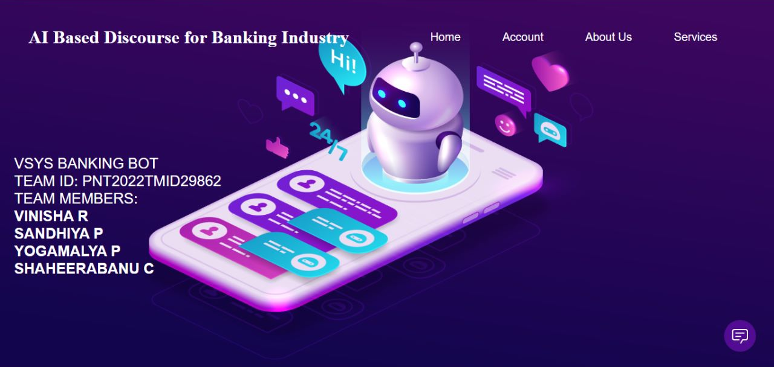

Slide 10
APP.PY CODE
import email
from email import message
from importlib.resources import contents
from tkinter import S
from turtle import title
from flask import Flask, redirect,render_template,
request,session, url_for, Flask
from pyexpat import model
from werkzeug.utils import secure_filename
import ibm_db
from flask_mail import Mail, Message
from markupsafe import escape
from flask import Flask,render_template,request
import requests

Slide 11
app = Flask(name)
app.secret_key = b'_5#y2L"F4Q8z\n\Xec]/‘
mail = Mail(app)
conn = ibm_db.connect("DATABASE=bludb;HOSTNAME=1bbf73c5-d84a-4bb0-85b9-ab1a4348f4a4.c3n41cmd0nqnrk39u98g.databases.appdomain.cloud;PORT=32286;SECURITY=SSL;SSLServerCertificate=DigiCertGlobalRootCA.crt;UID=hzj88231;PWD=z8f4ZiZ171T0FvR1",'','')
print(conn)print("connection successful...")
@app.route('/', methods = ['GET','POST'])
def signup():
return render_template('signup.html')
@app.route('/login', methods=['GET','POST'])
def login(): return render_template('login.html')
@app.route('/index')
def index():
return render_template('index.html')
@app.route('/account')
def account():
return render_template('account.html')

Slide 12
@app.route('/aboutus')
def aboutus():
Return render_template('aboutus.html')
@app.route('/services')
def services():
return render_template('services.html')
@app.route('/register', methods=['GET', 'POST'])
def register():
if request.method == 'POST':
uname = request.form['uname']
mail = request.form['email']
phone = request.form['phone']
password = request.form['password']
sql = "SELECT * FROM customer WHERE email=?"
stmt = ibm_db.prepare(conn, sql) ibm_db.bind_param(stmt,1,mail)
ibm_db.execute(stmt)
account = ibm_db.fetch_assoc(stmt)
if account:
return render_template('index.html', msg="You are already a member, please login using your details....")

Slide 13
else:
insert_sql = "INSERT INTO customer VALUES (?,?,?,?)" prep_stmt = ibm_db.prepare(conn, insert_sql) ibm_db.bind_param(prep_stmt, 1, uname) ibm_db.bind_param(prep_stmt, 2, mail) ibm_db.execute(prep_stmt)
return render_template('login.html', msg="Student Data saved successfuly..")
@app.route('/signin', methods=['GET', 'POST'])def signin(): sec = ''
if request.method == 'POST':
mail = request.form['email']
password = request.form['password']
sql = f"select * from customer where email='{escape(mail)}' and password= '{escape(password)}'"
if data:
session["mail"] = escape(mail)
session["password"] = escape(password)
return redirect(url_for('index'))
else:
return render_template('login.html',msg = "Invalid email/ Password or Not registered!!?")
return "not going to happen dickhead!!??"

Slide 14
HTML CODE
<!DOCTYPE html>
<html lang="en">
<head>
<meta charset="UTF-8">
<title>VSYS BANK</title>
<link rel="stylesheet" href="../static/css/style.css/login.css">
<style>
body {
background-image: url('static/1.png');
background-repeat: no-repeat;
background-attachment: fixed;
background-size: 100% 100%;
}
h1 {
color: white;
}
.detail{
font-size: 26px;
color: white;

Slide 15
font-family:sans-serif;
}
</style>
<!---we had linked our css file----->
</head>
<body>
<div class="full-page">
<div class="navbar">
<p>
<h1>AI Based Discourse for Banking Industry </h1>
</p>
<nav>
<ul id='MenuItems'>
<li><a href=" {{ url_for('login') }}">Home</a></li>
<li><a href=" {{ url_for('account') }}">Account</a></li>
<li><a href=" {{ url_for('aboutus') }}">About Us</a></li>
<li><a href=" {{ url_for('services') }}">Services</a></li>
</ul>
</nav>
</div>
<p class="detail">VSYS BANKING BOT<br> TEAM ID: PNT2022TMID029862 <br> TEAM MEMBERS:<br> <B>VINISHA R<br>

Slide 16
<script>
window.watsonAssistantChatOptions = {
integrationID: "1206a417-c053-4bee-a810-037a99f37b2a", // The ID of this integration.
region: "us-south", // The region your integration is hosted in.
serviceInstanceID: "e81248c6-9605-415f-843b-666356f451ec", // The ID of your service instance.
onLoad: function (instance) { instance.render(); }
};
setTimeout(function () {
const t = document.createElement('script');
t.src = "https://web-chat.global.assistant.watson.appdomain.cloud/versions/" + (window.watsonAssistantChatOptions.clientVersion || 'latest') + "/WatsonAssistantChatEntry.js";
document.head.appendChild(t);
});
</script>
</body>
</html>

Slide 17
ADVANTAGES
Chatbots have 24/7 Availability: Chatbots can be available to solve customer problems 24/7 whether it is day or night! They don’t need to sleep after all!
This is much more difficult to achieve using human customer service as it would require rotating teams that would be more complicated to manage as well.
Chatbots can gather Customer Insights: Companies thrive on customer data! The more data they have, the better they can cater to their customers and be much more successful. That’s where chatbots can be a big help.
Whenever you interact with any chatbots on a company page, you provide basic data such as user preferences, buying habits, sentiments, etc. which can then be analysed to understand market trends, operational risks, etc.
Using this information, the company can solve customer issues much easier and create targeted products. This will help in increasing their customer loyalty.

Slide 18
DISADVANTAGES
Chatbots sound too Mechanical: Chatbots are not human and so obviously they cannot interact as a human with customers. They sound too mechanical and can only give answers to problems that they have been programmed with.
They cannot answer a customer according to the context and they cannot show any emotions if needed.
Chatbots also cannot maintain a natural-sounding conversation in-depth with customers and that is why they are only useful in solving basic queries. But this can create a disconnect with customers who prefer the human approach when solving their problems.
Chatbots can only handle basic Questions: Chatbot are still a basic Artificial Intelligence technology and so they can only answer the basic questions of customers and provide general information that is already available to them.
They cannot solve complicated queries or answer out of script questions and companies need to have human customer service employees that can manage these for them. However, this is changing with time and currently, more and more advanced chatbots are entering the market.

Slide 19
FUTURE SCOPE
Chatbots are Now Based on Natural Language Processing(NLP) The goal is to allow users and Artificial Intelligence to communicate naturally and understand complex requests.
This would mean that customer service agents would be able to focus on other tasks while the AI takes care of customers' queries.
Chatbots in finance, in the digital banking and healthcare industries might save more than 12 billion USD in a year by 2022.
According to several estimates, financial organizations might save 2 trillion USD by 2030 by implementing artificial intelligence and cutting costs by 35%.
In the digital banking business, banks with Chatbots can automate a variety of functions in addition to enhancing everyday operations and the universal consumer experience as fund transfer, Notifications & Alerts at the Right Time, Get help from a Customer Service Representative, simple lead generation

